Slide 1
Data-Driven Customer Segmentation and Product Recommendation System for SMEs
A case study using the UCI Online Retail dataset
Emeka Hilary Nwosu | Student ID: 20023332
Supervisor: Michael Ajao-Olarinoye
Department of Computer Science and Technology, Ulster University

Slide 2
Introduction & Problem Statement
Why SME e-commerce needs a low-cost analytics pipeline
SMEs generate transaction data but lack the tools to turn it into insight
No segmentation means generic marketing and untargeted recommendations
Problem: no low-cost, repeatable pipeline exists from raw transactions to actionable segments and recommendations

Slide 3
Aim & Research Questions
Designing and evaluating a segmentation & recommendation system for SMEs
Aim: build an SME-scale pipeline from raw transactions to segments and recommendations
RQ1–RQ2: Can transaction data support segmentation, and which clustering technique works best?
RQ3–RQ4: Can buying trends drive product recommendations, and does personalisation help?
RQ5: How can this analytics support real SME decision-making?

Slide 4
Methodology Overview
A repeatable, five-stage pipeline
Data acquisition & preprocessing
Feature engineering (RFM)
Customer segmentation & evaluation
Product recommendation & evaluation
Delivery via an interactive web application

Slide 5
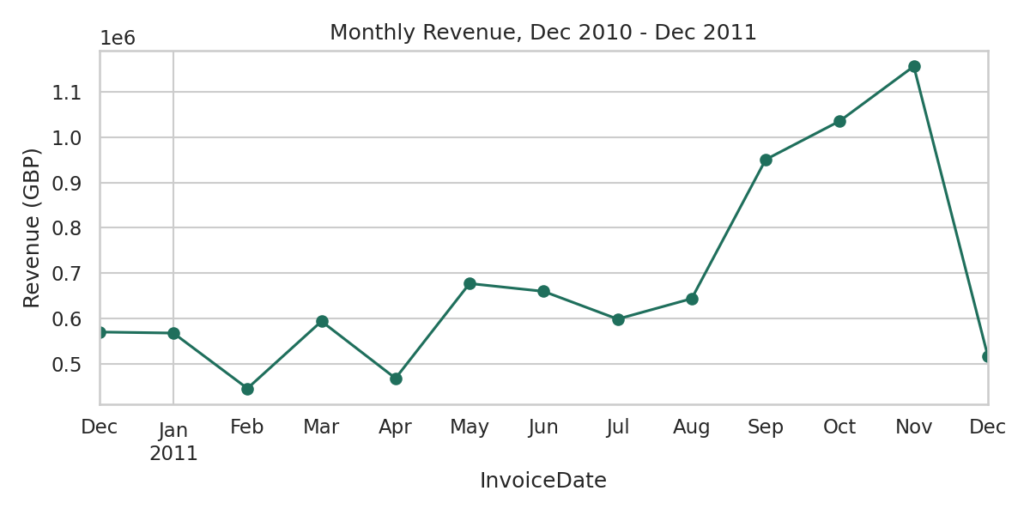
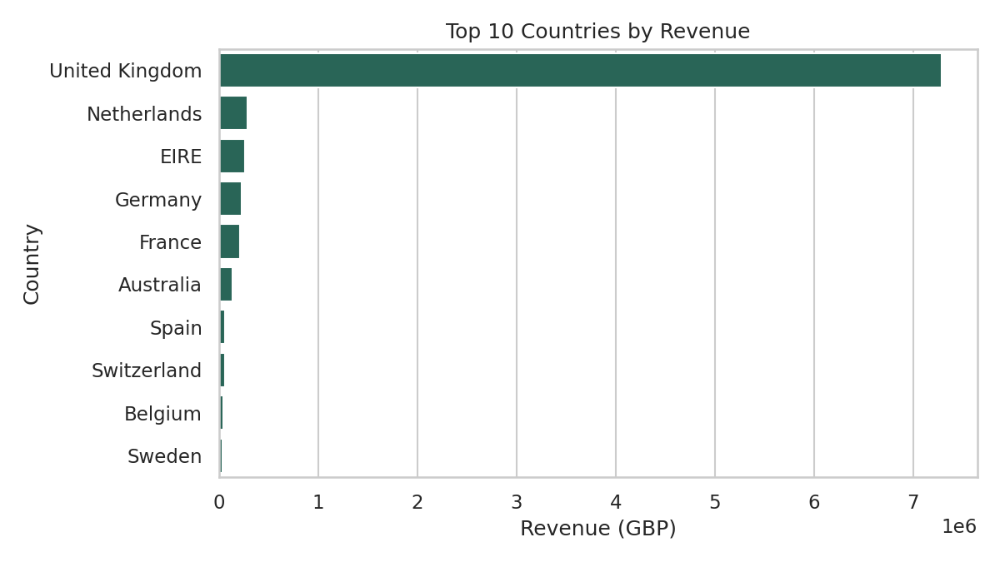
Exploratory Data Analysis
Seasonal demand, and a UK-dominated market
Fig. 4.1 — Monthly revenue, Dec 2010–Dec 2011
Fig. 4.2 — Top 10 countries by revenue

Slide 6
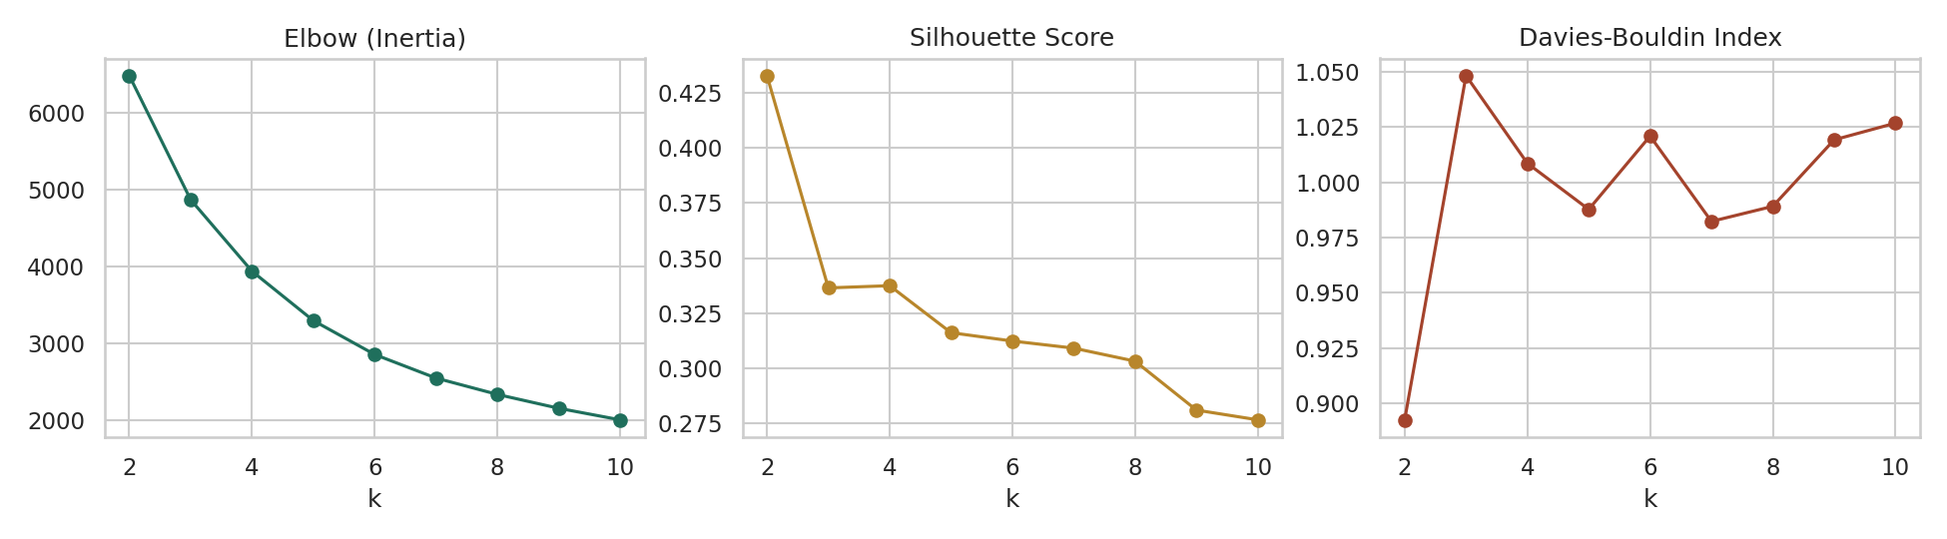
Choosing the Number of Clusters
Silhouette score and Davies-Bouldin index both peak at k = 2
Fig. 4.3 — Elbow, Silhouette, and Davies-Bouldin curves for k = 2 to 10

Slide 7
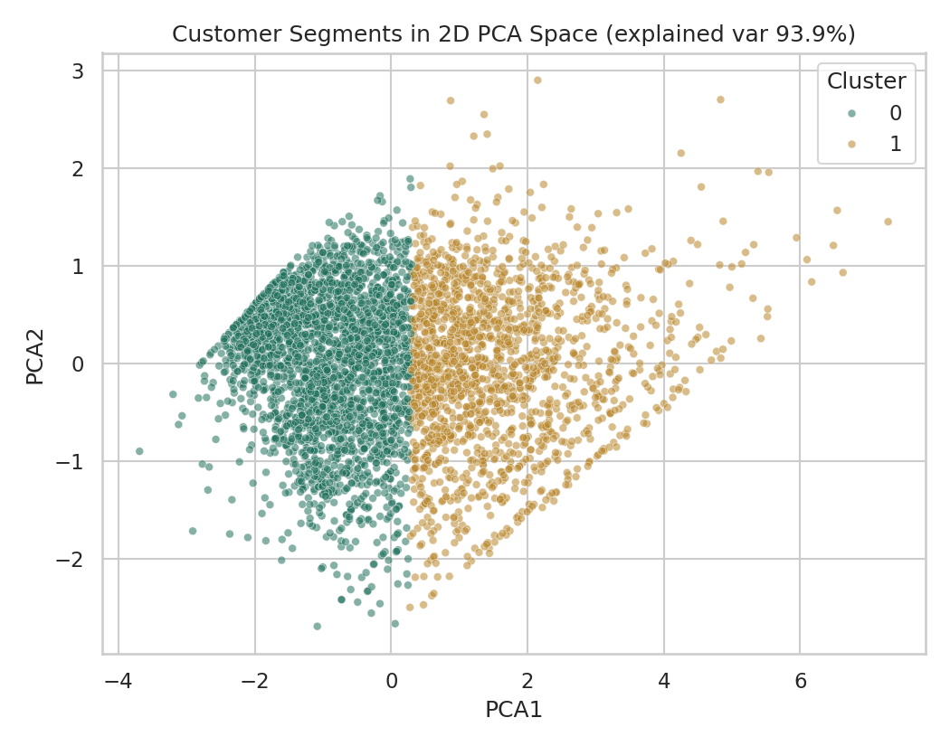
Customer Segments, Visualised
Two clusters, cleanly separated in PCA space
Fig. 4.5 — Customer segments projected into 2D PCA space (93.9% variance explained)

Slide 8
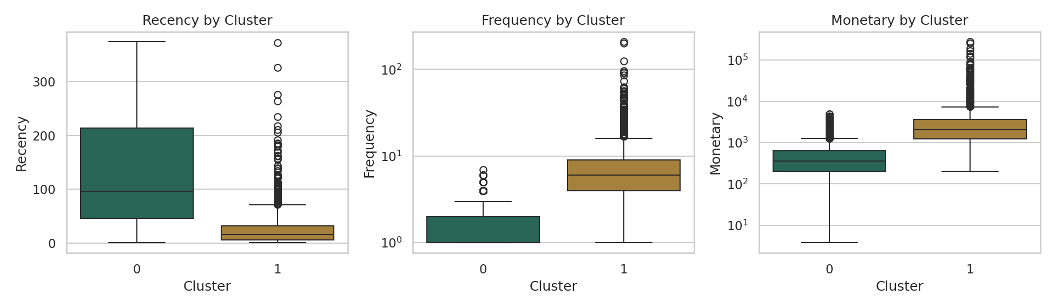
Segment Behaviour Profiles
High-Value Active customers buy more recently, more often, and spend more
Fig. 4.6 — Recency, Frequency, and Monetary value by segment

Slide 9
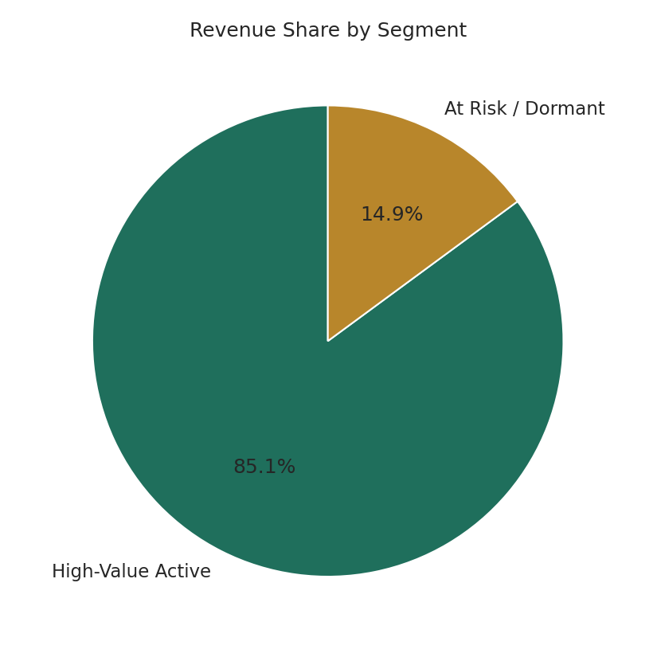
Revenue by Segment
A minority of customers drive the majority of revenue
Fig. 4.4 — High-Value Active: 38.4% of customers, 85.1% of revenue

Slide 10
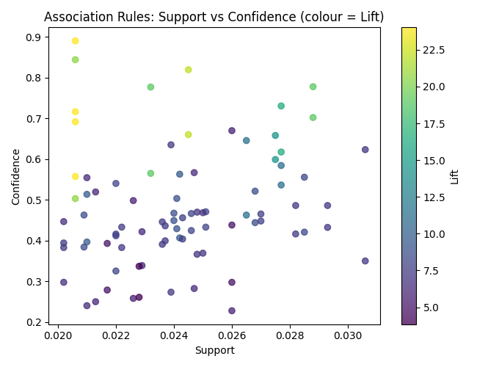
Association Rule Quality
86 rules mined — strongest patterns combine high support with high lift
Fig. 4.7 — Support vs. confidence for all mined rules, coloured by lift

Slide 11
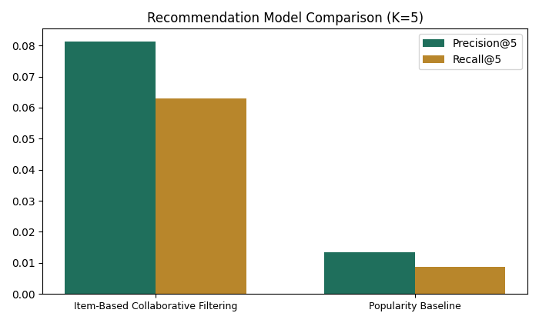
Recommendation Performance
Personalisation beats a popularity baseline by ~6-7x
Fig. 4.8 — Precision@5 and Recall@5, item-based CF vs. popularity baseline

Slide 12
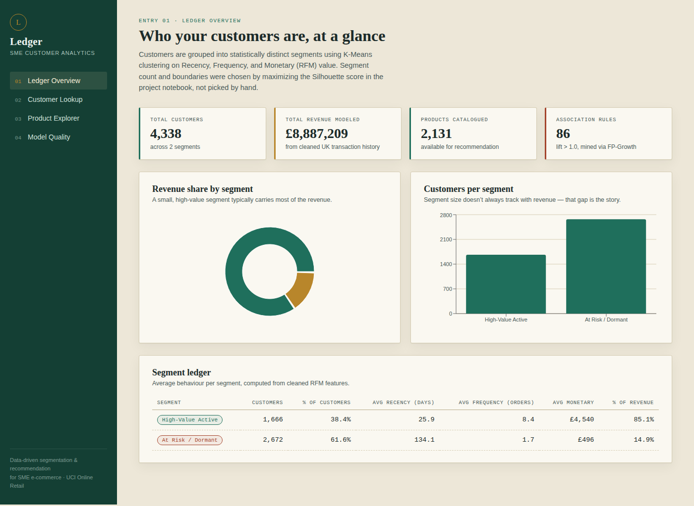
Live System — Ledger Overview
Segments, revenue share, and association rules in one dashboard

Slide 13
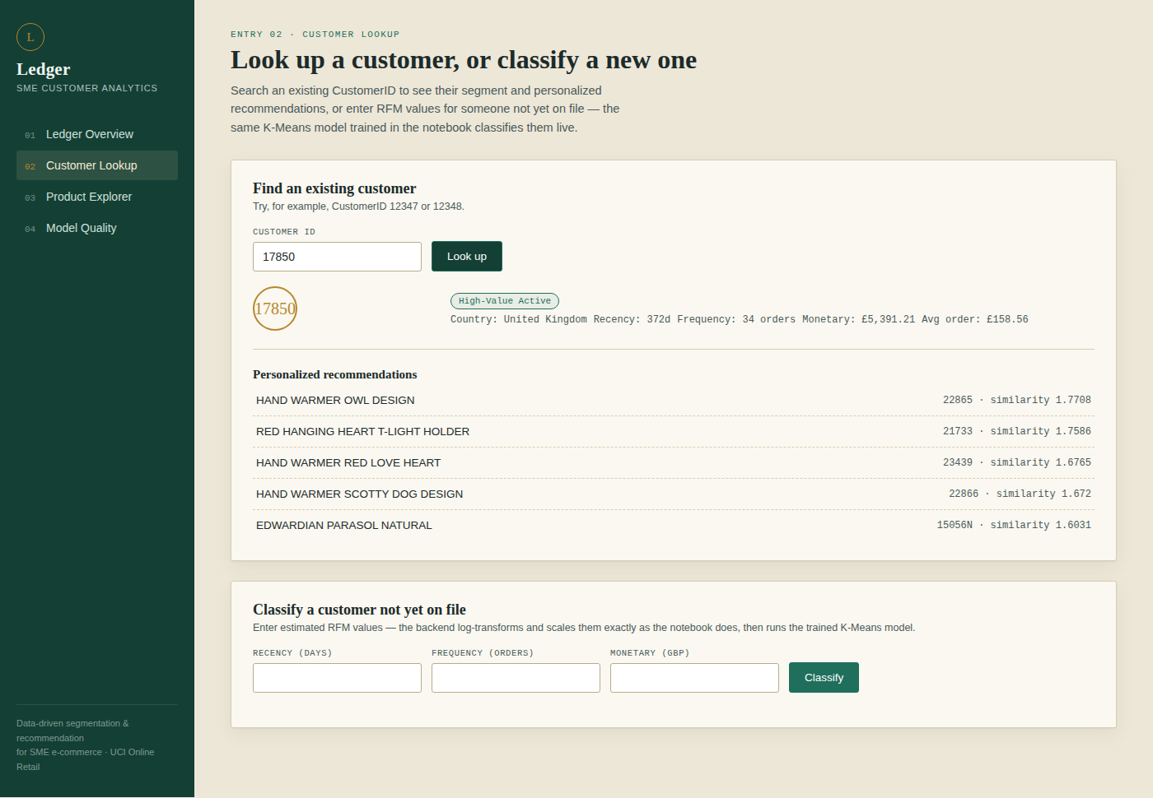
Live System — Customer Lookup
Live segment classification and personalised recommendations

Slide 14
Key Findings & Contributions
What this study shows, and what's next
A repeatable pipeline takes SMEs from raw transactions to segments and recommendations
K-Means segmentation and item-based CF both outperform simple baselines
Delivered as a working dashboard, not just a report
Limitation: single dataset and only two statistically distinct segments (k = 2)
Future work: multi-dataset validation and richer behavioural features

Slide 15
References
[1] J. Han, M. Kamber, and J. Pei, Data Mining: Concepts and Techniques, 3rd ed. Morgan Kaufmann, 2011.
[2] C. C. Aggarwal, Recommender Systems: The Textbook. Springer, 2016.
[3] P.-N. Tan, M. Steinbach, and V. Kumar, Introduction to Data Mining, 2nd ed. Pearson, 2018.
[4] A. Géron, Hands-On Machine Learning with Scikit-Learn, Keras, and TensorFlow, 3rd ed. O’Reilly, 2022.
[5] D. Chen, “Online Retail,” UCI Machine Learning Repository, 2015.
[6] J. MacQueen, “Some methods for classification and analysis of multivariate observations,” 1967.
[7] J. H. Ward, “Hierarchical grouping to optimize an objective function,” J. Am. Stat. Assoc., 1963.
[8] M. Ester et al., “A density-based algorithm for discovering clusters with noise,” KDD, 1996.
[9] D. L. Davies and D. W. Bouldin, “A cluster separation measure,” IEEE TPAMI, 1979.
[10] P. J. Rousseeuw, “Silhouettes: A graphical aid to cluster validation,” J. Comput. Appl. Math., 1987.
[11] R. Agrawal, T. Imieliński, and A. Swami, “Mining association rules in large databases,” ACM SIGMOD, 1993.
[12] J. Han, J. Pei, and Y. Yin, “Mining frequent patterns without candidate generation,” ACM SIGMOD Record, 2000.
[13] B. Sarwar et al., “Item-based collaborative filtering recommendation algorithms,” WWW, 2001.
[14] A. M. Hughes, Strategic Database Marketing. Probus Publishing, 1994.
[15] R. T. Fielding, “Architectural styles and the design of network-based software architectures,” Ph.D. dissertation, UC Irvine, 2000.

